Slide 1

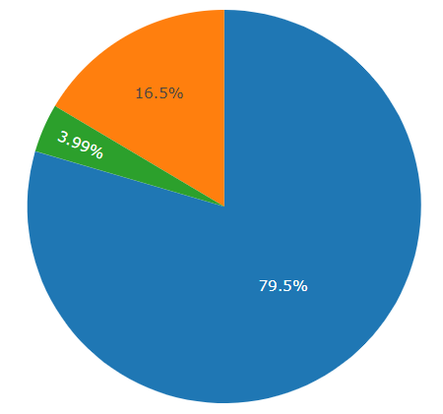
COVID-19 Exploratory Data Analysis
A Primer on .Net DataFrame and ML.net
Praveen Raghuvanshi

Slide 2

Introduction
Cloud Architect @ Harman
Domain: Audio, Video, Control
Area of Expertise: Cloud, Distributed computing
Area of Interest: AI/ML, Cloud and IoT
Location: Bangalore, India

Slide 3
Acknowledgements
Dataset - John Hopkins University CSSE
Python Visualization - Akshay Sb
Organizers - Alexander and Jon
Sponsors - Excella and Wintellect

Slide 4

COVID-19
As per Wiki…
“Coronavirus disease 2019(COVID-19) is an infectious disease caused by severe acute respiratory syndrome coronavirus 2 (SARS-CoV-2).
The disease was first identified in 2019 in Wuhan, the capital of China's Hubei province, and has since spread globally, resulting in the ongoing 2019–20 coronavirus pandemic”
Image Source: https://www.theweek.in/news/india/2020/03/29/coronavirus-will-see-its-end-soon-say-renowned-astrologers.html

Slide 5
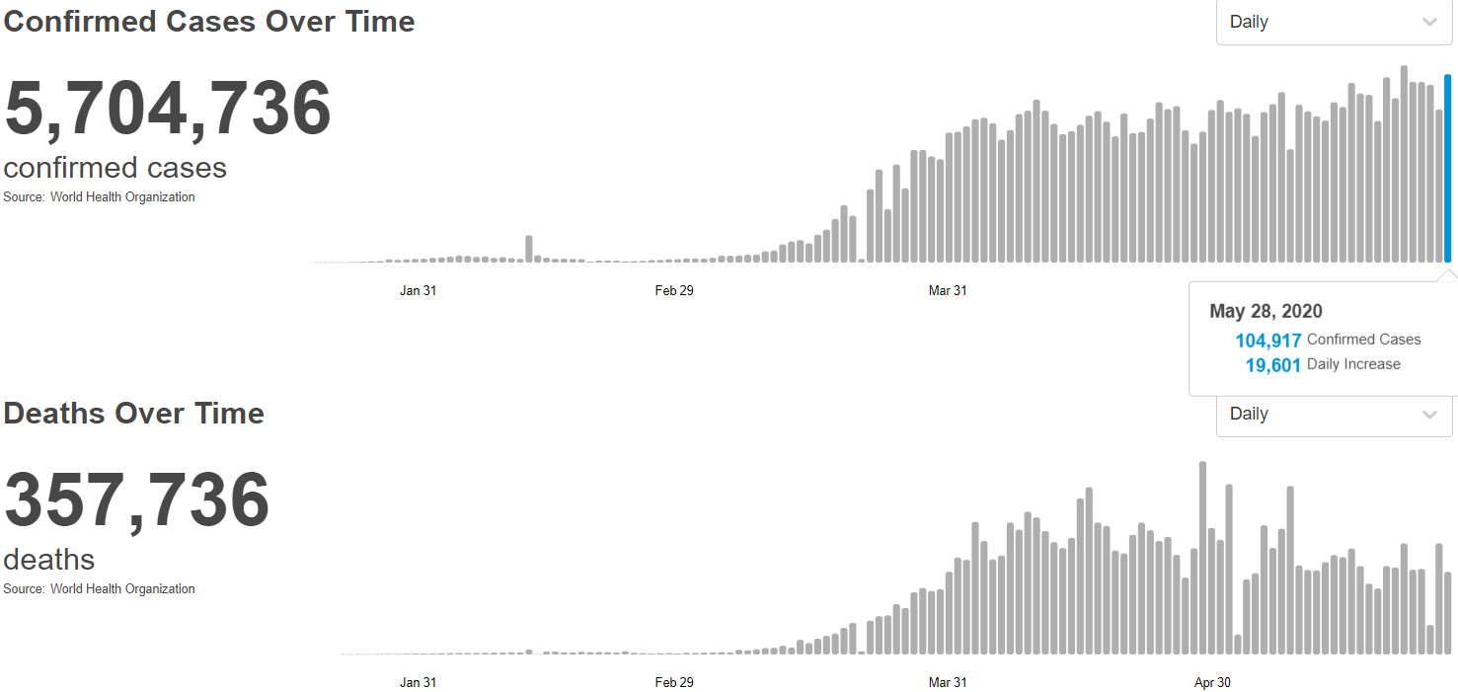
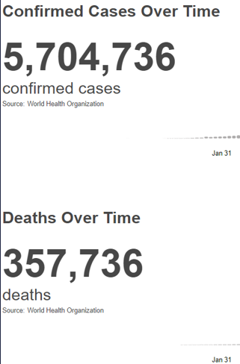
COVID-19 (Statistics) : May 28, 2020
Source: https://covid19.who.int/

Slide 6
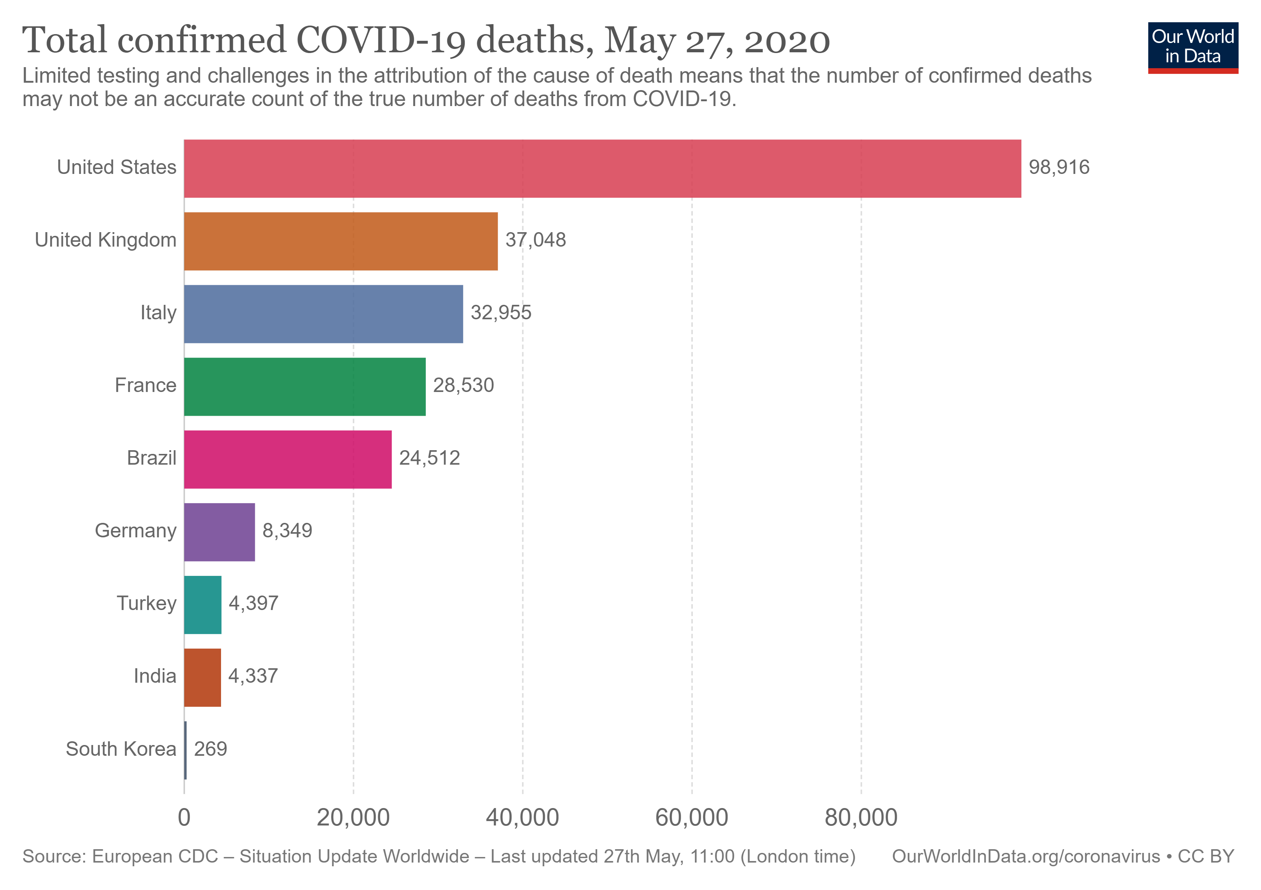
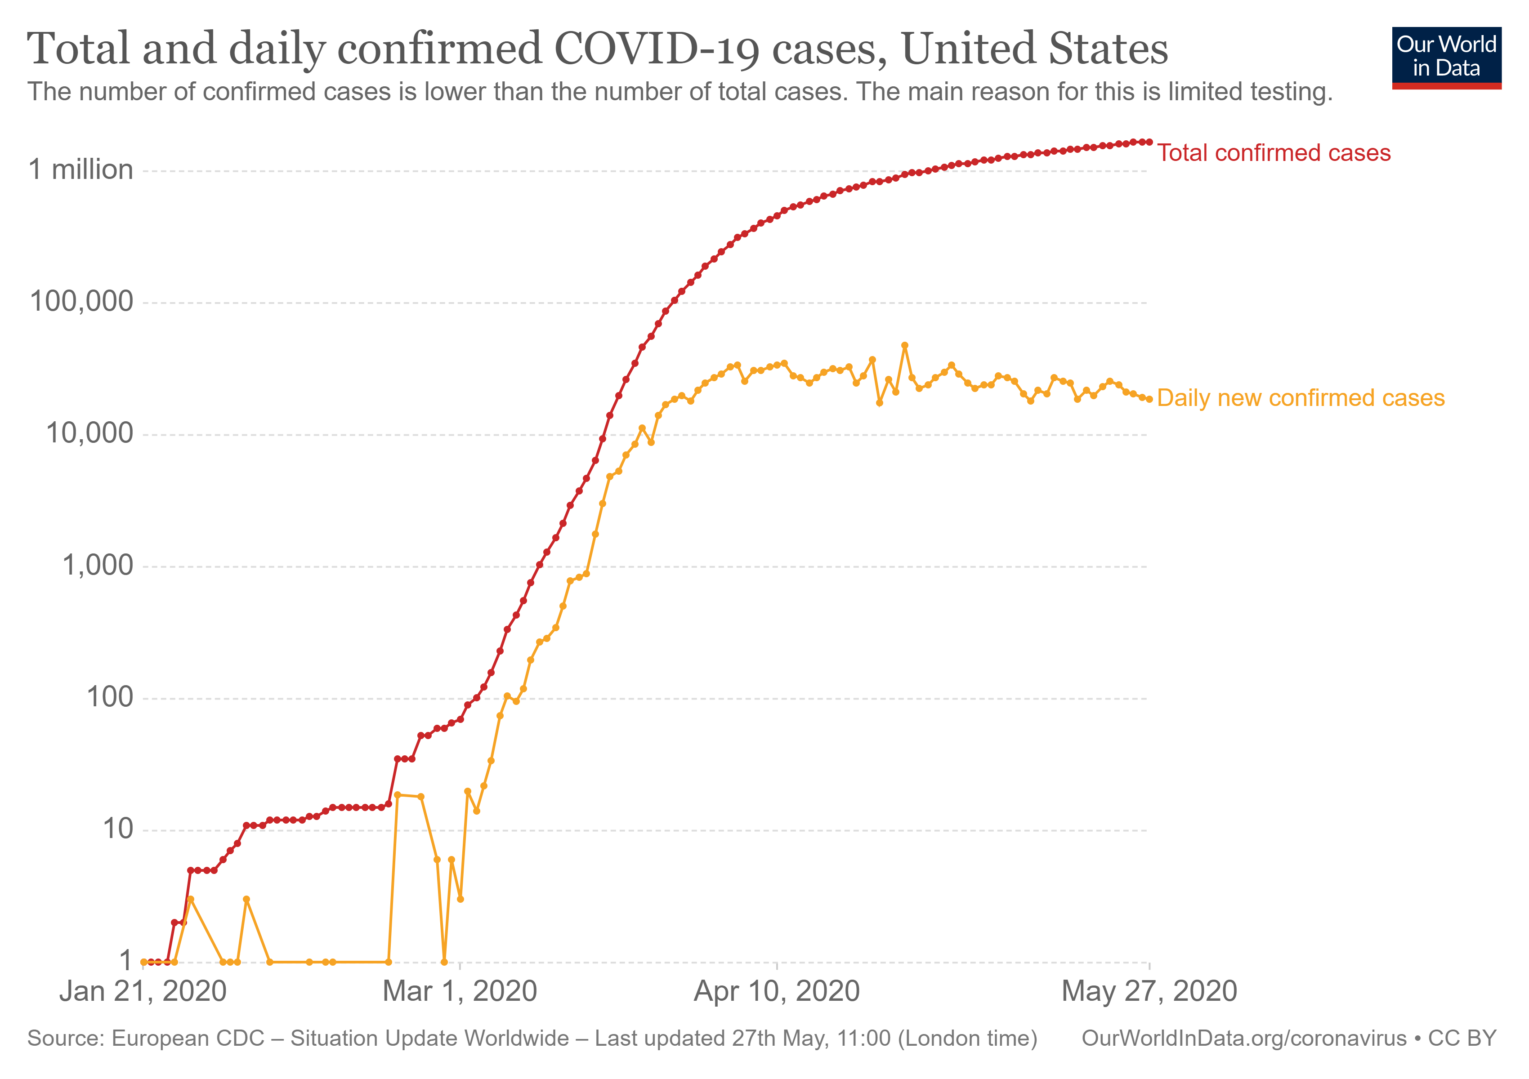
COVID-19 (Statistics) : May 27, 2020
Source: https://slides.ourworldindata.org/2020_pandemic/2020_pandemic#/title-slide

Slide 7
Exploratory Data Analysis - EDA
As per Wiki…
“In statistics, exploratory data analysis (EDA) is an approach to analyzing data sets to summarize their main characteristics, often with visual methods.
A statistical model can be used or not, but primarily EDA is for seeing what the data can tell us beyond the formal modeling or hypothesis testing task.”

Slide 8

EDA Contd…
Buy a house
No of bedrooms
Type(Apartment, Villa)
Locality
Crime rate

Slide 9
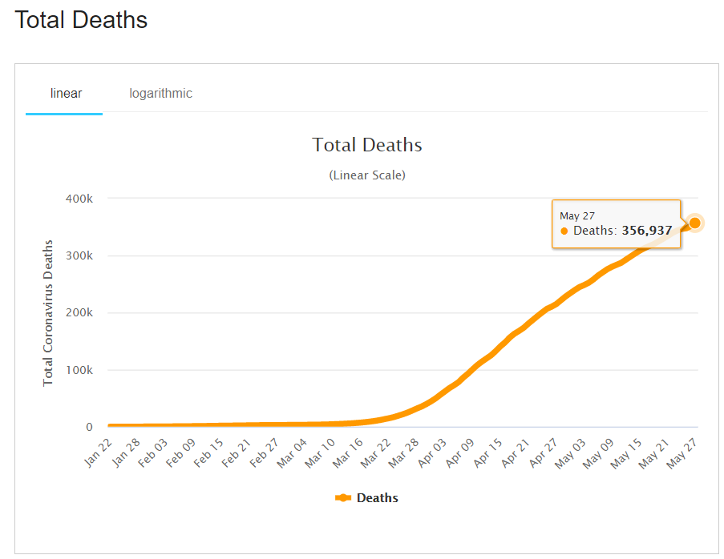
Time Series Analysis
The analysis of data organized across units of time.
It helps understand past trends and plan for future
Types: Trends, Seasonality, Irregularity, Cyclic

Slide 10
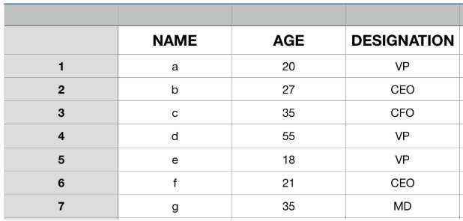
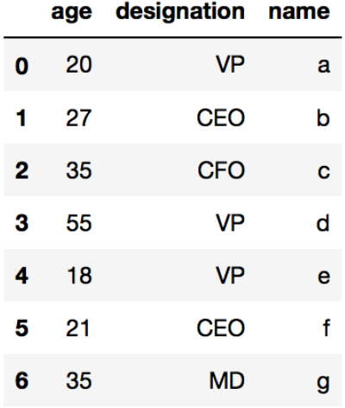
DataFrame

Slide 11
.Net DataFrame
A collection of columns
In-memory representation of structured data
Similar to Python Dataframe
Load dataset from CSV
Row/Column Selection
Join/Merge Dataframe
GroupBy
Null values

Slide 12
.Net DataFrame Vs IDataView
DataFrame | IDataView
Microsoft.Data | Microsoft.ML
Analogous to List | Analogous to IEnumerable
.Net Devs interested in Data science (Exploration) | .Net Devs interested in ML (Prediction)
Schemaless | Schema bound
Eagerly loaded | Lazy loaded
In-memory | Stream based, forward only cursor
Random access | No random access
Easy to debug | Hard to debug
Support only Csv | Support Csv, IEnumerable, Relational DB
Apache Arrow format | Schema based
Notes:
- SQL Server, Azure SQL Database, Oracle, SQLite, PostgreSQL, Progress, IBM DB2

Slide 13
ML.Net
Single Spectrum Analysis
TimeSeriesCatalog.ForecastBySsa
Time Series
Load Data – MLContext
ML Pipeline
Predicting confirmed cases in next 7 days
Notes:
SSA is a powerful framework for decomposing the time-series into trend, seasonality and noise components as well as forecasting the future values of the time-series.
In principle, SSA performs spectral analysis on the input time-series where each component in the spectrum corresponds to a trend, seasonal or noise component in the time-series. For details of the Singular Spectrum Analysis (SSA), refer to this document.

Slide 14
Visualization
Xplot – Plotly
Bar
Scatter
Pie

Slide 15
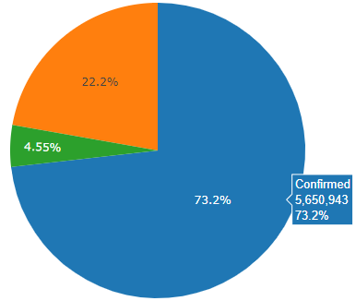
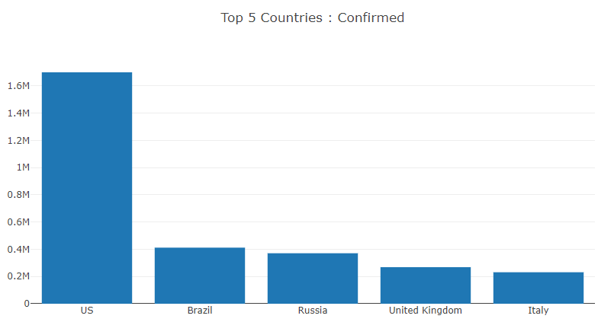
Dataframe

Slide 16
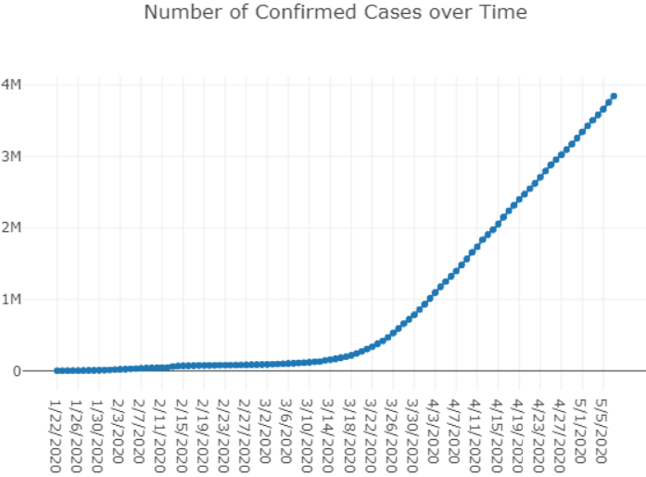
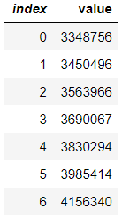
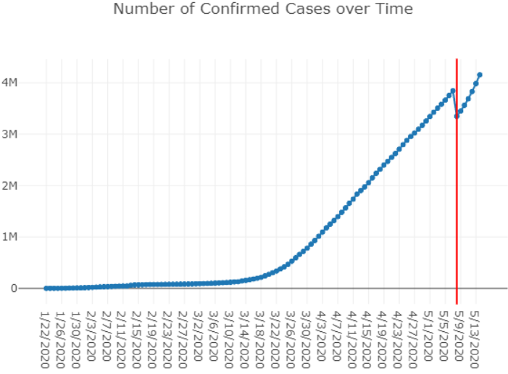
ML.Net – Prediction(7 Days)

Slide 17
Demo

Slide 18
References
https://github.com/praveenraghuvanshi1512/TechnicalSessions/tree/master/31052020-virtualmlnet

Slide 19





Thank you Q & A
praveenraghuvanshi@gmail.com
https://in.linkedin.com/in/praveenraghuvanshi
https://github.com/praveenraghuvanshi1512
@praveenraghuvan
https://t.me/joinchat/IifUJQ_PuYT757Turx-nLg

